Slide 1


SALES REPORT
FOR OFFICE SUPPLY
PRESENTED BY:
HASSAN SULIAT & ALAUSA MUSTAPHA
SEPTEMBER 22nd, 2023

Slide 2

CONTENTS
01
Executive Summary
Key Findings
02
Recommendations
03
Conclusion
04

Slide 3
EXECUTIVE SUMMARY
This report aims to review the company’s financial performance from January to December 2013 & 2014. Data was analyzed to obtain revenue and profits, as well as sales performance of products, state and segments.

Slide 4
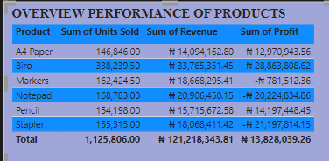
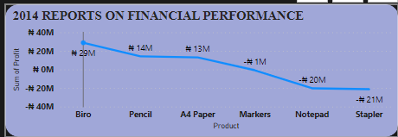
KEY FINDINGS
The 3 key products that had the highest performance were Biro, A4 Paper and Pencil making up 53.8% of total sales.
The Poor performing products were Stapler, Notepad and Marker.
The Products with the highest tax was Biro.
The Segment with the highest tax was Small Business.
The State with the highest tax was Osun.
The highest profit was recorded in December of Q4 2014.
More profit was generated in December 2014 compared to 2013 due to higher quantity of Biro sold.

Slide 5
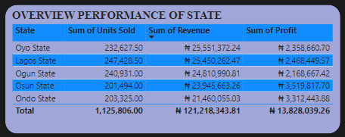
RECOMMENDATION
The quantity of Biro being the highest profit generating products should be increased in subsequent years.
The sale of the 3 poor performing products( Stapler, Notepad and Marker) should be stopped as they keep incurring losses.
More focus should be on the best performing state being Osun in terms of advertisement and product purchase.

Slide 6

CONCLUSION
Osun and Ogun State generated the highest profit of about 3.5million and 3.3million and some products (A4 Paper, Biro, Pencil) made about 53.8% of total sales between 2013 & 2014

